Slide 1
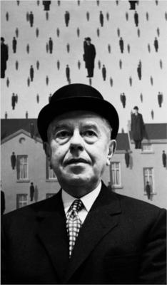
Rene Magritte
Belgian Artist
1898-1967

Slide 2
Surrealism: A movement in art and literature that flourished in the early twentieth century. Surrealism aimed at expressing imaginative dreams and visions free from conscious rational control.

Slide 3
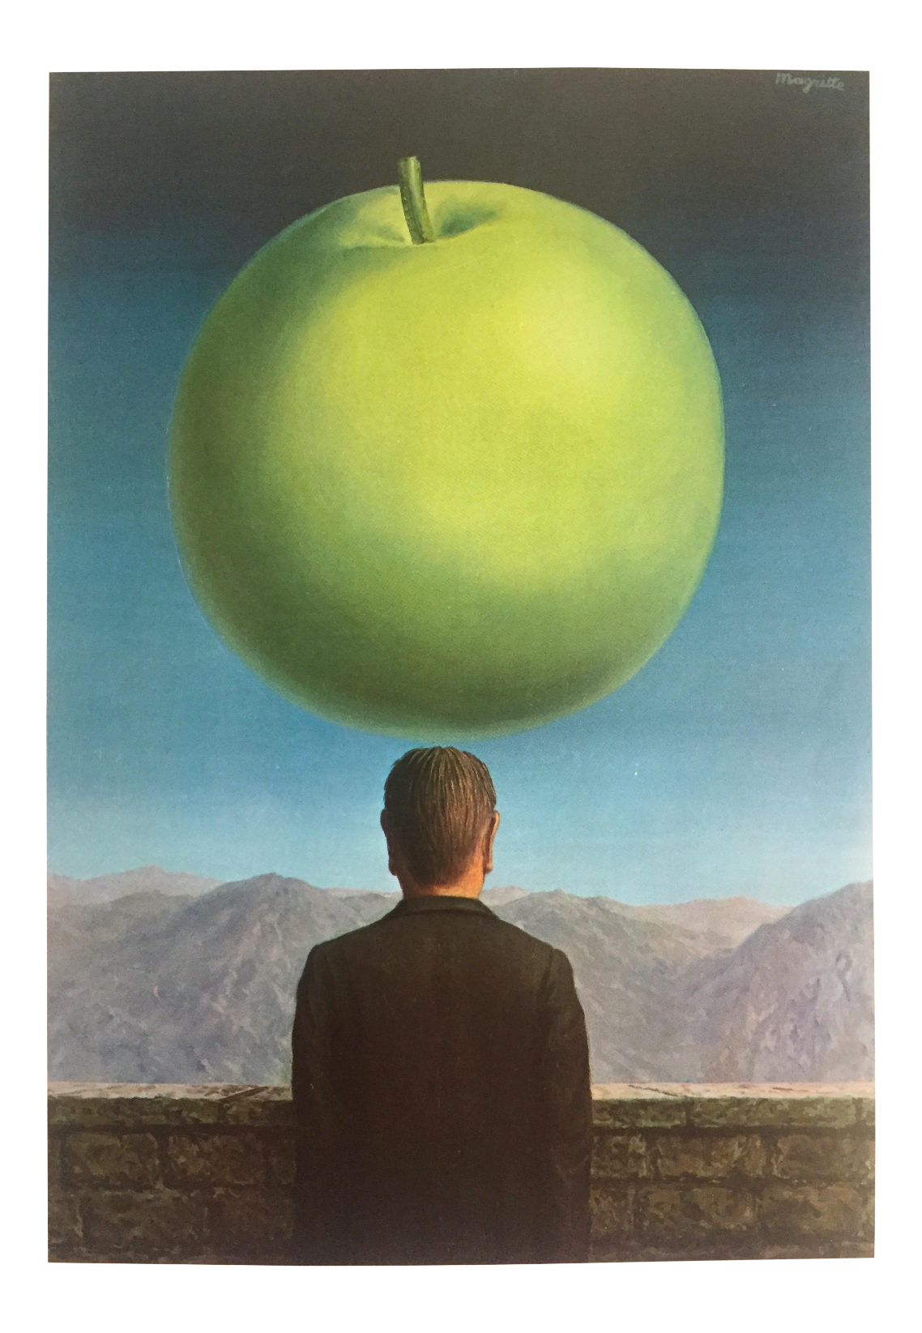
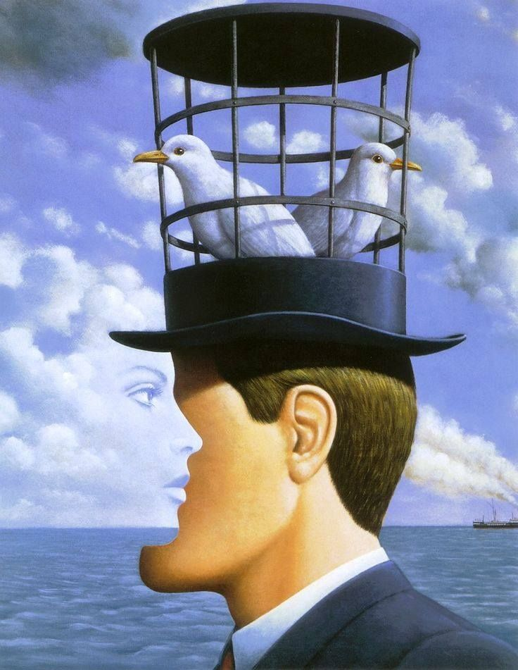

Slide 4
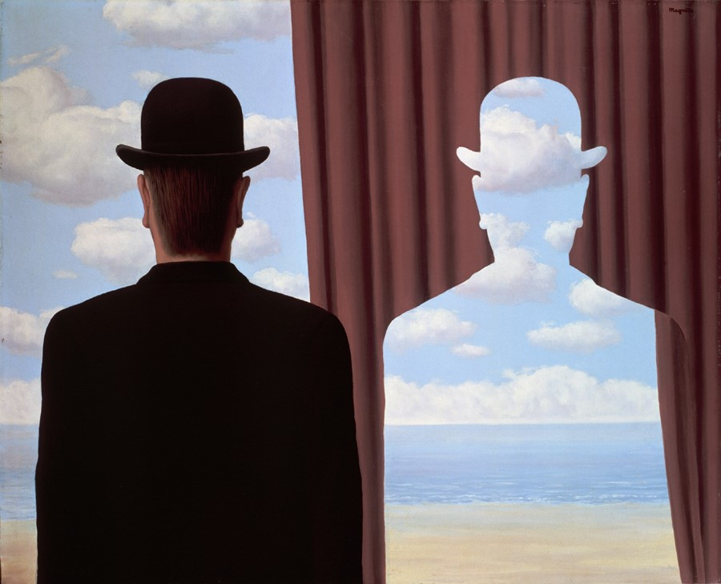

Slide 5
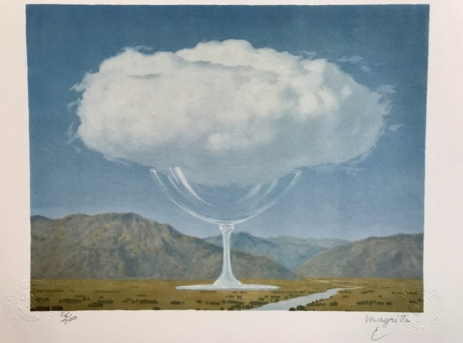

Slide 6
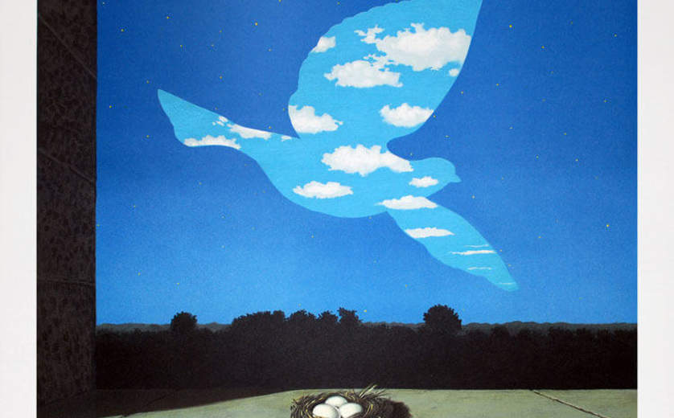

Slide 7
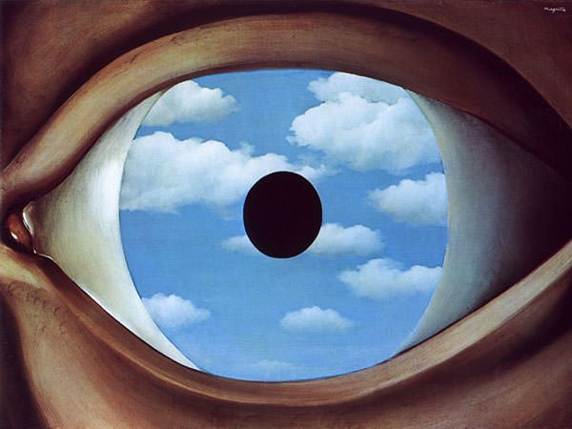
The inspiration for our project!

